Slide 1
Eclipse World Wide
Group: IDontThink
By Piotr Warkocki, Victor Costello, Dylan Lowe, Josh Quirke, James McNeill, Sorin Stoleru.

Slide 2
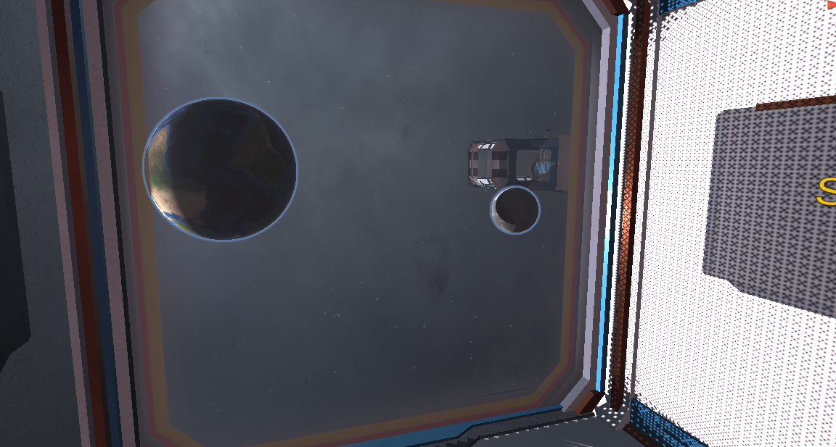
Our challenge:
Eclipse, Perspective is everything
The Goal is to create an experience where we teach young people about our world, and space we are encompassed by.

Slide 3
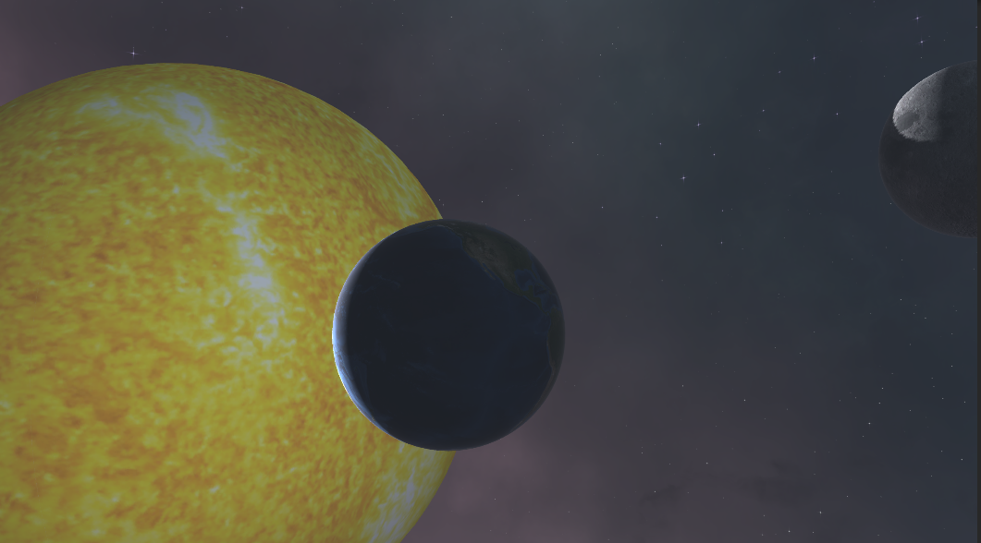
Game features
3D Models
Sound
UI

Slide 4
Stages of solar eclipses
First Contact
Fourth Contact
Partial Phase
Totality Ends
Totality Beginning

Slide 5
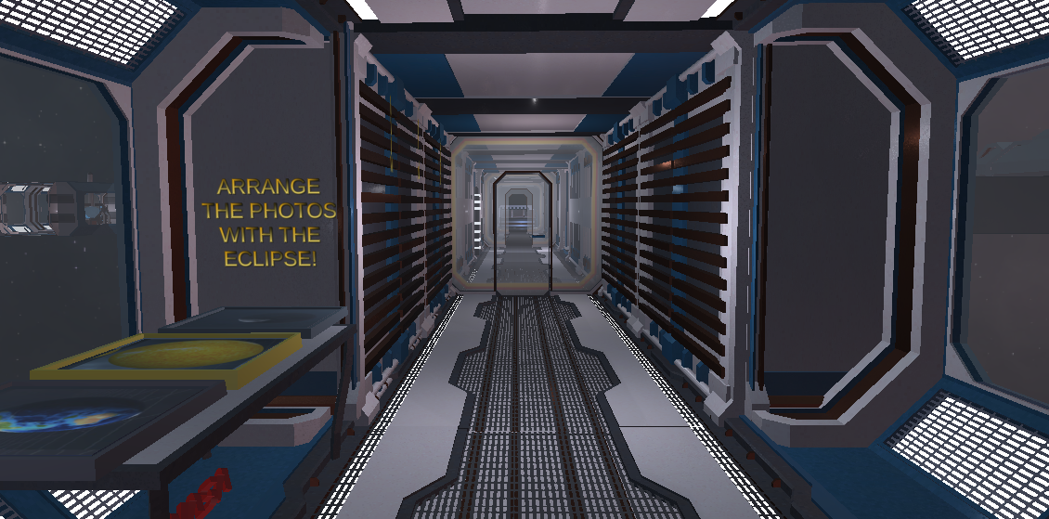
Learning Experience
Visual, Audible and Haptic

Slide 6
How it could Impact Learning:
Evolving learning
Positive stimulus
Accessible learning
Reinforced Learning

Slide 7
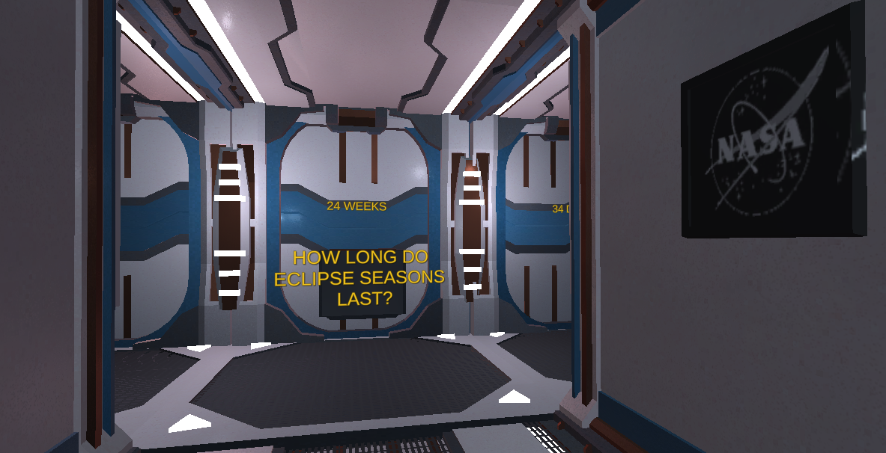
Future plans
Virtual Reality
Learning
Greater Immersion and Engagement

Slide 8
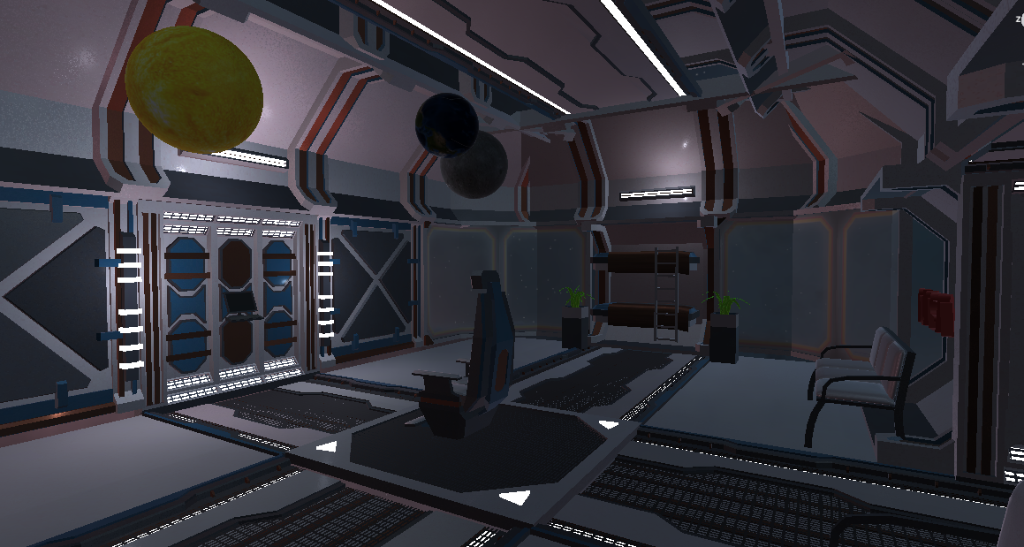
Thank you

Slide 9
Penumbral
Total
Parcial

